Slide 1
What is your life worth?
A predictive Analytics Approach to Assessing life Insurance Risk.
Presented by
Daniel dewitte
Modupe ajala

Slide 2
Introduction & motivation
Research have shown that only 40% of US citizens own life insurance
Getting life insurance is a long and tiring process
This study wants to accurately predict risk classification of customers
High impact on public perception of the industry

Slide 3
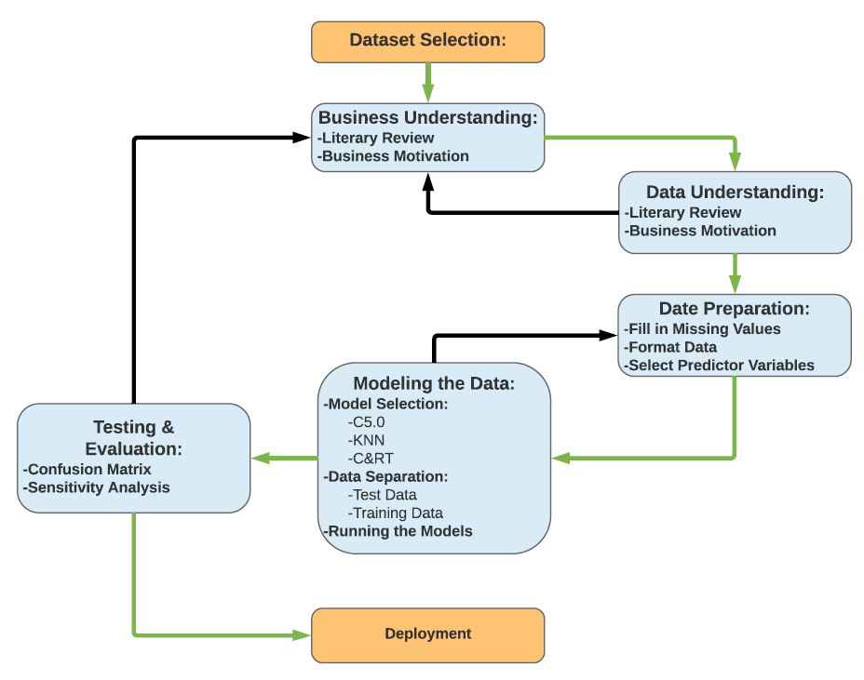
Data analytics Methodology
Business understanding​
Data understanding​
Data preparation​
Model building​
Testing & evaluation​
Deployment
CRISP-DM workflow

Slide 4
Business understanding
It is important to predict the risk of the customers accurately
A more accurate way of assessing risk in a shorter period is needed.
Managing loss coverage from adverse selection and high mortality rates among individuals
Data understanding
Dataset provided by Prudential Life Insurance downloaded from Kaggle.com
Before pre-processing it had 59,400 observations and 128 variables
A combination of normalized, continuous, and discrete variables.

Slide 5
Data preparation
Variable Name: | Reason:
Id | Unique identifier, not able to be data mined
Employment Info _1 | 0.00032% of entries were missing values, a value of 0.098184612 was entered for those missing values.
Employment Info _4 | 11% of entries were missing values, variable removed
Employment Info _6 | 18% of entries were missing values, variable removed
Insurance History_5 | 43% of entries were missing values, variable removed
Family Hist_2 | 48% of entries were missing values, variable removed
Family Hist_3 | 58% of entries were missing values, variable removed
Family Hist_4 | 32% of entries were missing values, variable removed
Family Hist_5 | 70% of entries were missing values, variable removed
Medical Hist_1 | 15% of entries were missing values, variable removed
Medical Hist_10 | 99% of entries were missing values, variable removed
Medical Hist_15 | 75% of entries were missing values, variable removed
Medical Hist_24 | 94% of entries were missing values, variable removed
Medical Hist_32 | 98% of entries were missing values, variable removed
Medical Keyword 1-48 | Dummy variables, variables removed
Product_Info | Variables are not used in calculating risk, variables removed
Removed entities (Id) and dummy variables ( medical keyword 1-48)
Filled in variables with less than 10% missing values using Excel
Removed variables with missing values of over 10%
After pre-processing 59,381 rows and 66 columns were left
Table 2. List of Variable that were removed from the original dataset.

Slide 6
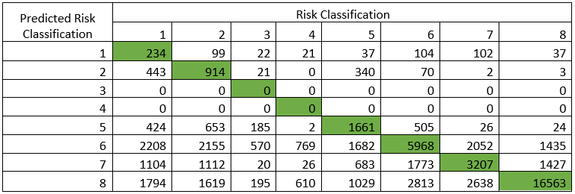
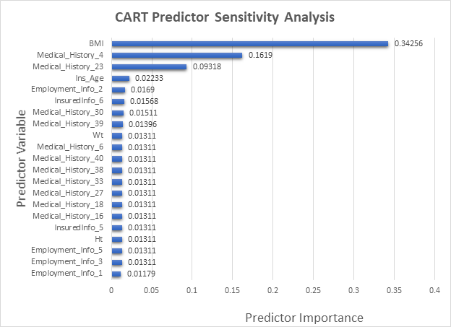
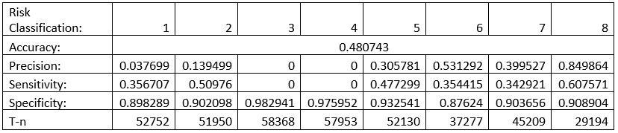
CART
CART Model: Results Evaluation

Slide 7

K-NN
The overall accuracy of the k-NN model was 54.02%.
Predicted Risk Classification | Risk Classification
 | 1 | 2 | 3 | 4 | 5 | 6 | 7 | 8
1 | 1587 | 246 | 34 | 27 | 157 | 197 | 97 | 72
2 | 490 | 1778 | 43 | 31 | 261 | 242 | 98 | 77
3 | 13 | 29 | 115 | 9 | 27 | 37 | 16 | 18
4 | 27 | 43 | 31 | 231 | 23 | 49 | 33 | 51
5 | 218 | 312 | 52 | 32 | 1278 | 223 | 109 | 83
6 | 1274 | 1450 | 350 | 402 | 1112 | 6176 | 1260 | 764
7 | 594 | 668 | 75 | 76 | 589 | 694 | 3011 | 524
8 | 2004 | 2026 | 313 | 620 | 1985 | 3615 | 3403 | 17900
Risk Classification: | 1 | 2 | 3 | 4 | 5 | 6 | 7 | 8
Accuracy: | 0.540172783
Precision: | 0.255679 | 0.271368 | 0.113524 | 0.161765 | 0.235272 | 0.549809 | 0.375109 | 0.918467
Sensitivity: | 0.656599 | 0.588742 | 0.435606 | 0.473361 | 0.553966 | 0.482953 | 0.483229 | 0.561727
Specificity: | 0.918896 | 0.915296 | 0.98481 | 0.979675 | 0.927217 | 0.891464 | 0.905626 | 0.94225
T-n | 52344 | 51587 | 58219 | 57696 | 52920 | 41536 | 48134 | 25926
Result Evaluation
Confusion Matrix

Slide 8
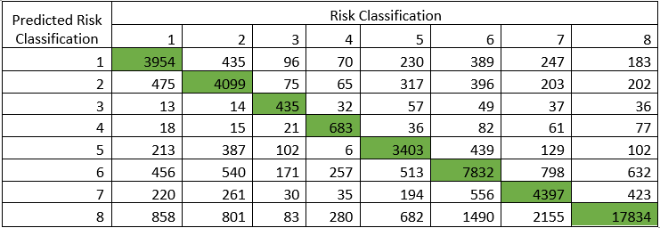
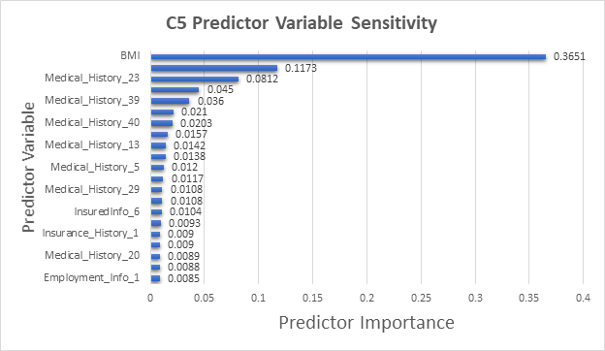
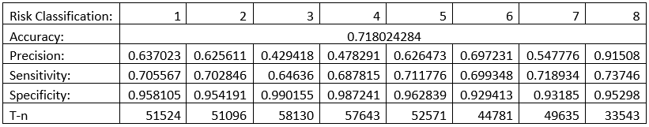
C5.0
Results Evaluation of the C5 Model.

Slide 9
TESTING & EVALUATION
Each model was subject to a 10-fold cross validation and then evaluated using a confusion matrix
The C5 model had an overall accuracy of 71.8
K-NN had accuracy of 54.02%
CART had overall accuracy of 48.07%

Slide 10
CONCLUSION
The best model to use is the C5 Decision Tree Model with an accuracy of 71.8% in predicting the risk classification of the entry.
The most important variables to the models was BMI, Medical_History_4, and Medical_History_23.
Not knowing the true identity most of the predictor variables made it difficult for creating a more indepth results analysis of the risk classification.

